Slide 1

Analysis and implementation of Deep Neural Network based Text to Speech (TTS) systems
Submitted by-
Apoorva Mahajan K-05 GR No: 161393
Prathamesh Doundkar K-26 GR No.161307
Shreya Killedar K-45 Gr No: 161536
Shoumik Nandi K- 58 Gr No:161009

Slide 2
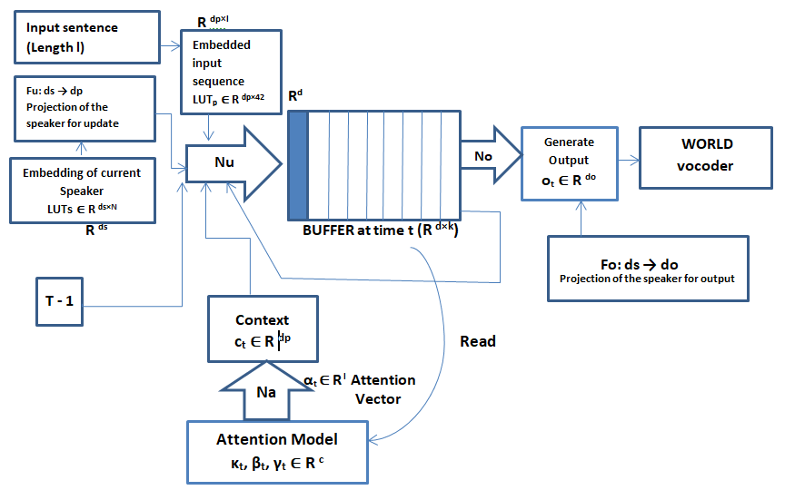
BLOCK DIAGRAM

Slide 3
Parameter | Description | Computed as:
d | dimensionality of the buffer | dp + do
k | capacity of the buffer | 20
dp | dim. of the input embedding LUT | 256
do | dim. of the vocoder feature vector | 63
ds | dim. of the speaker embedding | dp
c | # GMM component (attention model) | 10
s1 . . . sl, 1 ≤ si ≤ 42 | input sequence
l | length of the input sequence
N | number of speakers in the training set

Slide 4
Variable | Description | Computed as:
S_{t} ∈ R ^{d×k} | buffer at time t | S_{t}[1] = u_{t}; S_{t}[i + 1] = S_{t−1}[i]
u_{t} ∈ R^{d} | new representation for the buffer | Nu([S_{t−1}, [c_{t} + tanh(F_{u}z), o_{t−1}]])
E ∈ R ^{dp×l} | embedding of the input sequence | E[i] = LUT_{p}[s_{i} ]
z ∈ R ^{ds} | embedding of the current speaker | LUT_{s}[id]
κ_{t}, β_{t}, γ_{t} ∈ R ^{c} | 2 attention model parameters | Na(S_{t−1})
µ_{t}, σ² _{t} , γ' _{t} ∈ R ^{c} | attention GMM parameters | µ_{t} = µ_{t−1} + e ^{κt} , σ² _{t} = e ^{βt} , γ' _{t} = sm(γ_{t})
α_{t} ∈ R ^{l} | attention vector at time t
c_{t} ∈ R ^{dp} | context vector at time t | c_{t} = Eα_{t}
o_{t} ∈ R ^{do} | output vector at time t | No(S_{t}) + F_{o}z

Slide 5
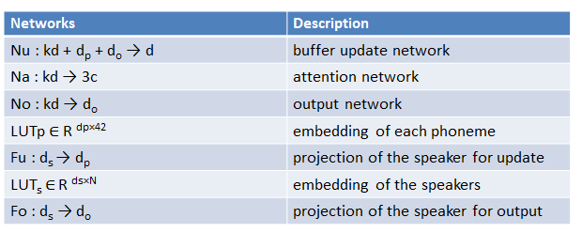

Slide 6
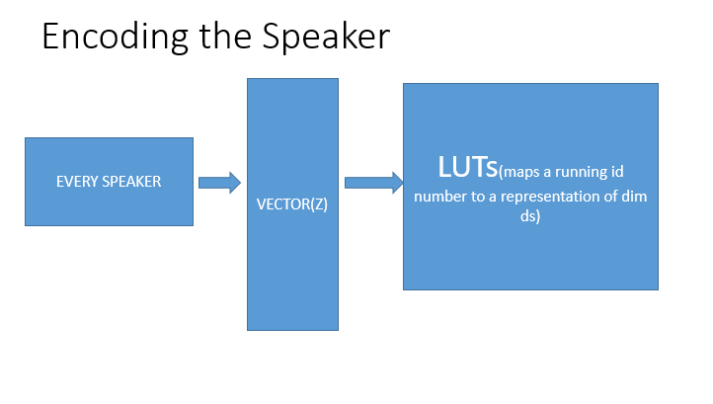

Slide 7
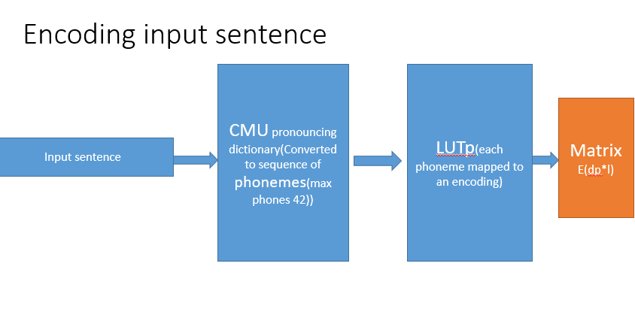

Slide 8
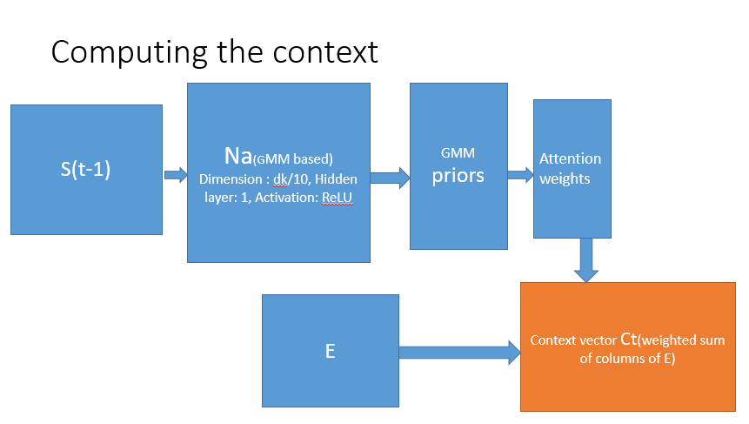
GMM priors γt, shifts κt, and log-variances βt

Slide 9
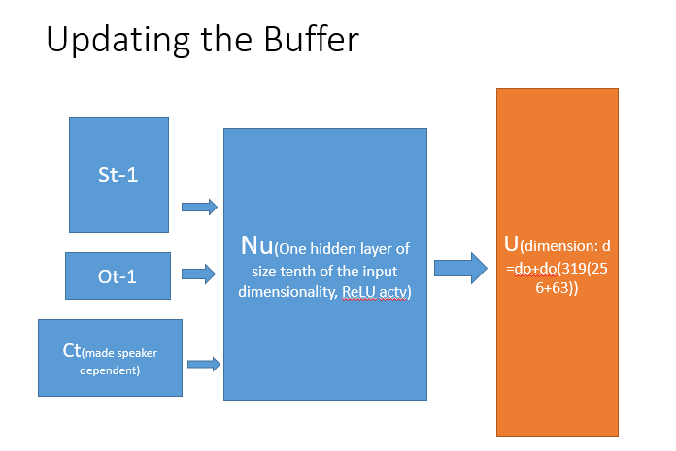

Slide 10
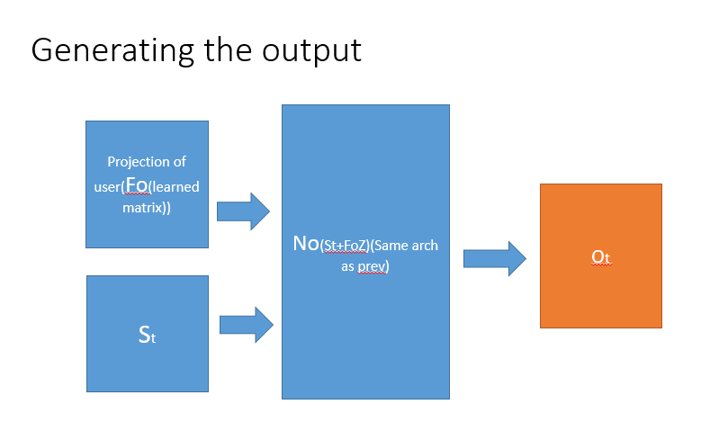

Slide 11
Attention Model
Graves Attention takes the context vector of time t-1 and passes it through couple of fully connected layers ([FC > ReLU > FC] in our model) and estimates step-size(shifts), variance and distribution weights(priors) for time t. Then the estimated step-size is used to update the mean of Gaussian modes. (g,b,k)=FC(ReLU(FC(c)))))
nn.Linear(dim_in, dim_in/10),
nn.ReLU(),
nn.Linear(dim_in/10, dim_out)

Slide 12
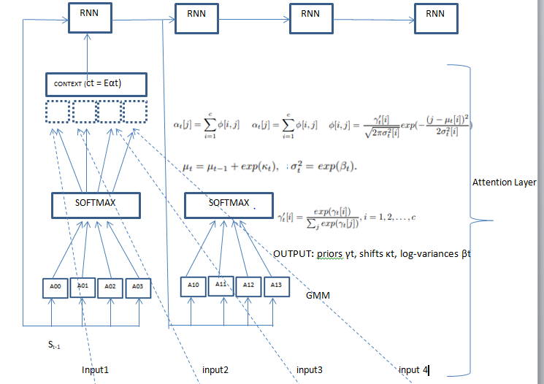

Slide 13
Phonemizer
The phonemizer allows simple phonemization of words and texts in many languages.
Provides both the phonemize command-line tool and the Python function phonemizer.phonemize.
It is using backends: espeak and festival
espeak supports a lot of languages and IPA (International Phonetic Alphabet) output.
festival currently supports only American English. It uses a custom phoneset, but it allows tokenization at the syllable level.

Slide 14
Character to Code Mapping
char2code = {'aa': 0, 'ae': 1, 'ah': 2, 'ao': 3, 'aw': 4, 'ax': 5, 'ay': 6, 'b': 7, 'ch': 8, 'd': 9, 'dh': 10, 'eh': 11, 'er': 12, 'ey': 13,
'f': 14, 'g': 15, 'hh': 16, 'i': 17, 'ih': 18, 'iy': 19, 'jh': 20,
'k': 21, 'l': 22, 'm': 23, 'n': 24, 'ng': 25, 'ow': 26, 'oy': 27, 'p': 28, 'pau': 29, 'r': 30, 's': 31, 'sh': 32, 'ssil': 33, 't': 34, 'th': 35, 'uh': 36, 'uw': 37, 'v': 38, 'w': 39, 'y': 40, 'z': 41}

Slide 15
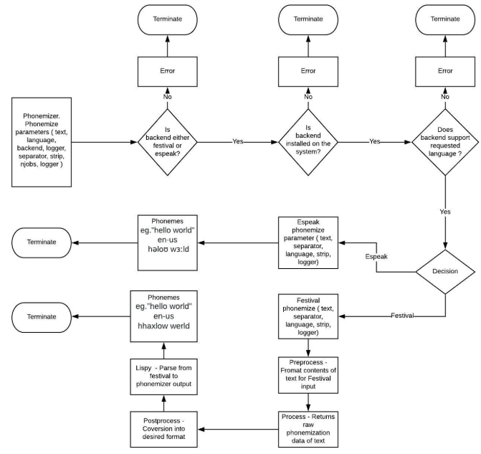

Slide 16
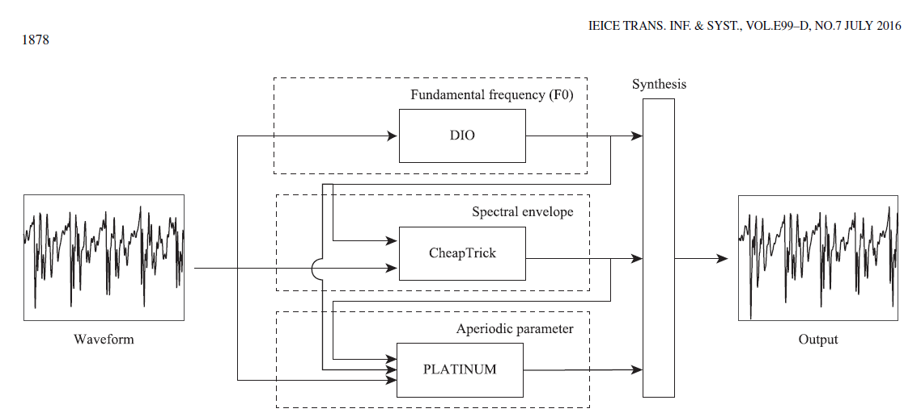
WORLD Vocoder Overview

Slide 17
Main code
Initialise struct WorldParameters
F0 Estimation using Harvest Algorithm
Spectrogram estimation using CheapTrick
Synthesis
Parameter Modification
Aperiodicity Estimation using D4C Algorithm

Slide 18
Block 6 - .wav file Synthesis
INPUT | OUTPUT
F0: F0 contour | Y: calculated speech
F0_length: Length of F0
Spectrogram: estimated by CheapTrick
Fft_size
Aperiodicity: based on D4C
Frame_period: Temporal period used for analysis
Fs: sampling frequency
Y_length: Length of output signal (memory for output signal has been allocated in advance)

Slide 19
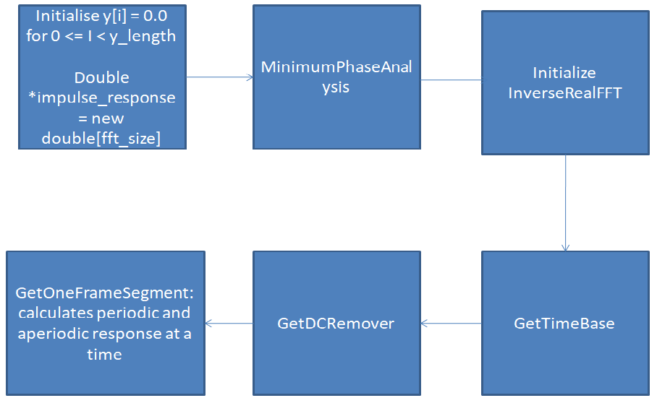

Slide 20
CODE
•response[i] = (periodic_response[i] * sqrt_noise_size + aperiodic_response[i]) / fft_size
•GetPeriodicResponse:
•Vuv<=0.5 || aperiodic_ratio > 0.999 à periodic_response = 0
•GetAperiodicResponse
•If vuv!=0 : continue

Slide 21

Command line arguments to run the code
Cmd line arguments specifying pretrained model location, speaker id and the input text
text = “this is natural sounding text to speech converter”
Spkr = 1

Slide 22
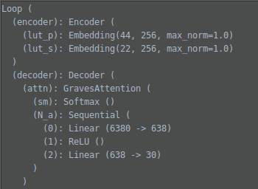
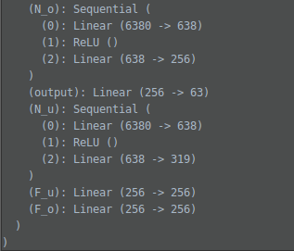
Extracting weights and training arguments from the pretrained model; Making the model ready
model = Loop(train_args)

Slide 23
TESTING
Selecting test data wisely to evaluate a text to speech system is important. Here a test data was created which includes all possible variations including numerals, dates, address, salutations, tongue twisters, homographs, difficult words, semantically unpredictable words, punctuations and sentences which evaluate prosody. Such data helps in verifying the system specifications, features, and in defining its limitations. Module testing was done for diagnosing the issues that may degrade the performance of specific modules.
Our system consists of four main modules: Phonemizer, Context generation, Buffer updation and Output generation. These modules were evaluated over different variations present in the test data.

Slide 24
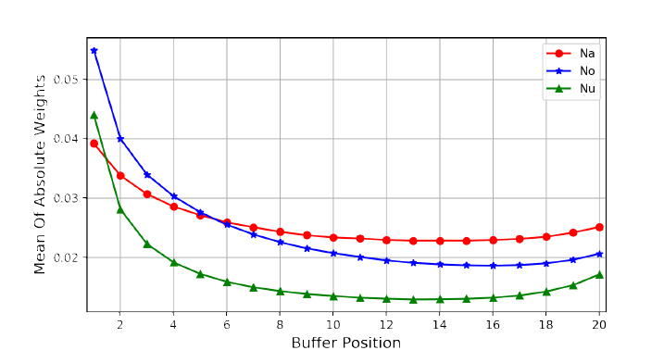
Memory Location Significance
Consider the relative role of each buffer location on the activations of Na, Nu, No

Slide 25
THANK YOU

